Slide 1
Financial Market Analyzer
Stock & Cryptocurrency Market Trend Visualization Tool

Slide 2

1. Problem Statement and Motivation
Investors struggle to interpret large volumes of financial market data.
Market trends change rapidly and require real-time monitoring.
Technical indicators are difficult for beginners to understand.
Goal: Develop an interactive visualization tool for market analysis.

Slide 3

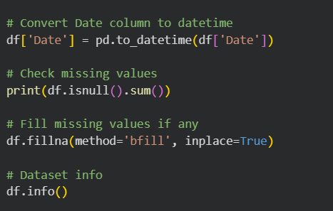
2. Data Description and Preprocessing
Dataset includes stock/crypto prices, volume, and market indicators.
Preprocessing steps: handling missing values, formatting dates, normalization.
Calculated indicators: SMA, EMA, volatility, moving averages.
Tools used: Python, Pandas, Plotly/Tableau/Power BI.

Slide 4
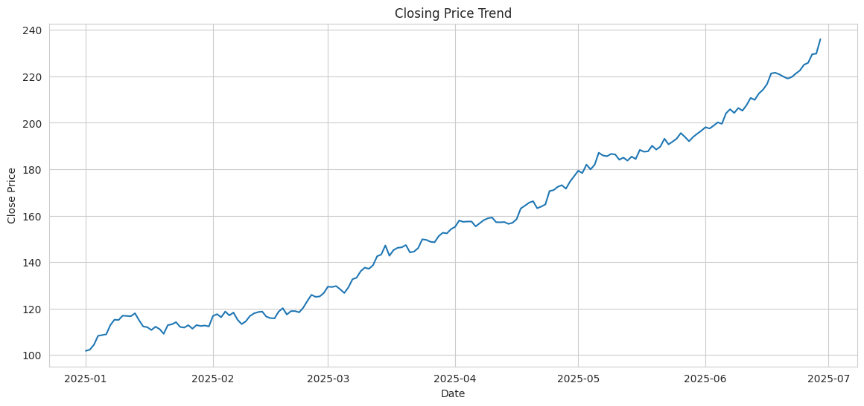
3. Key Visualization: Price Trend
Market Performance Overview (Jan – July 2025)
The asset demonstrated a consistent upward trajectory, growing from approximately $100 in January to nearly $240 by July.
Significant Represents a price increase of roughly 140% over a six-month period.

Slide 5
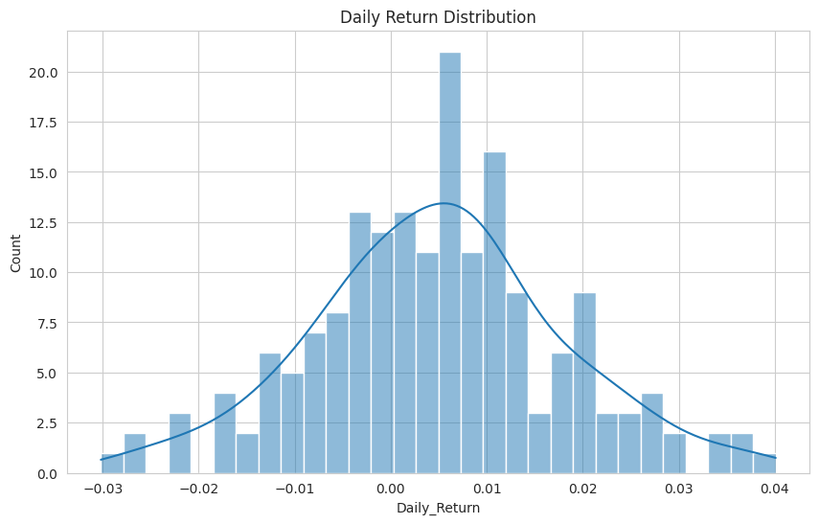
Daily Return Distribution
This histogram showing how frequently different levels of returns occur over a specific period.
Central Tendency: The distribution is centered slightly above 0.00, indicating a positive average daily return, with most data points clustering between -0.01 and +0.02.
Volatility & Shape: The bell-shaped curve (Kernel Density Estimate) suggests the returns are roughly normally distributed, though the "tails" at the far left and right represent the risk of extreme price movements.

Slide 6
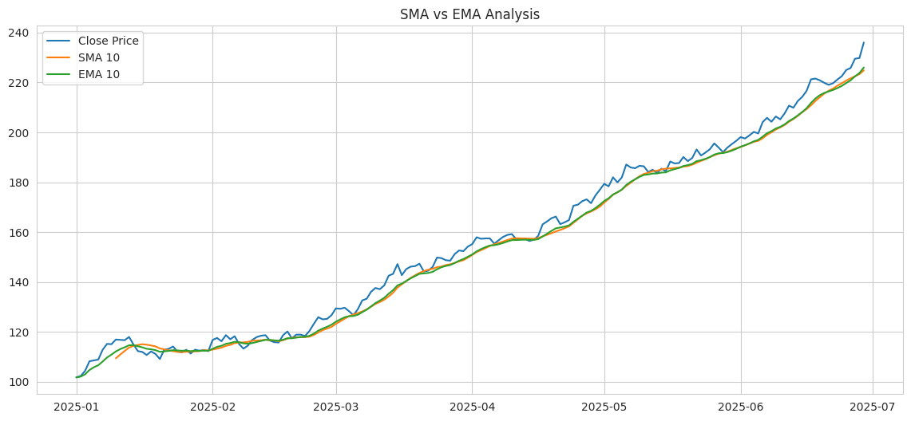
SMA vs EMA Analysis
Two lines to summarize the chart's main takeaway:
Trend Confirmation: Both the 10-period SMA and EMA confirm a strong, consistent bullish trend as the closing price remains predominantly above both moving averages.
Responsiveness Gap: The EMA (green) reacts more quickly to recent price fluctuations than the SMA (orange), providing a more sensitive indicator for short-term momentum shifts.

Slide 7
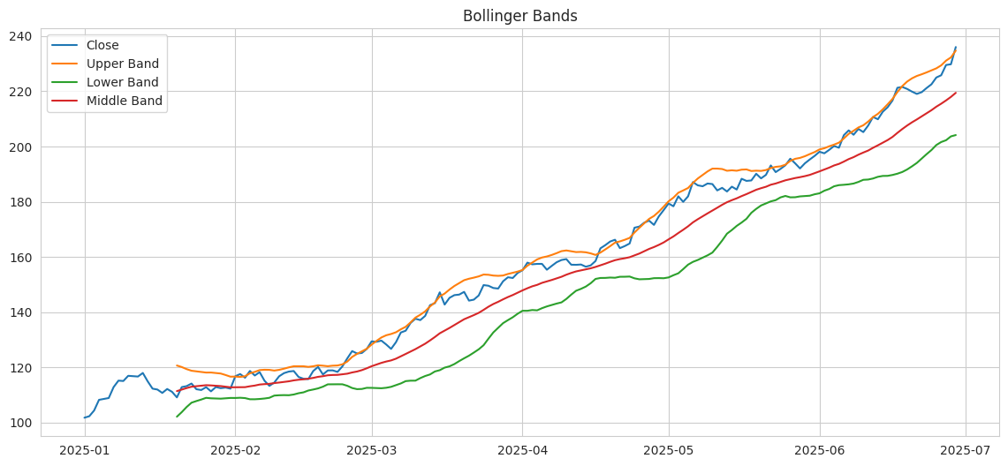
Bollinger Bands
The Bollinger Bands technical indicator highlights a strong upward trend and high price volatility from January to July 2025.
The price (blue line) consistently tracks near or above the Upper Band (orange), signaling a period of sustained bullish momentum and overbought conditions.

Slide 8
4. Dashboard Demonstration
Dashboard Features:
Real-time stock and crypto tracking
Interactive candlestick charts
Close Price Trend
Daily Return Distribution
SMA vs EMA Analysis
Technical indicators and filtering
User-friendly analytics dashboard

Slide 9
5. Insights and Recommendations
Key Insights:
Upward price trends were confirmed by SMA and EMA indicators.
High trading volume often preceded sharp price changes.
Increased volatility indicated uncertain market conditions.
Recommendation: Combine technical indicators with risk management strategies.

Slide 10
6. Challenges and Future Work
Challenges:
Real-time data integration and API limitations.
Noise and unpredictability in financial markets.
Handling large-scale streaming datasets.
Future Work: Add AI-based forecasting and sentiment analysis.

Slide 11
7. Q&A
Thank You!

